Slide 1

為 ADVENT 短宣代禱
Praying for ADVENT Mission
42 team members + 10 team parents
7/7 - 7/10 : served 346 students
265 YES 決志信主 (77%)

Slide 2
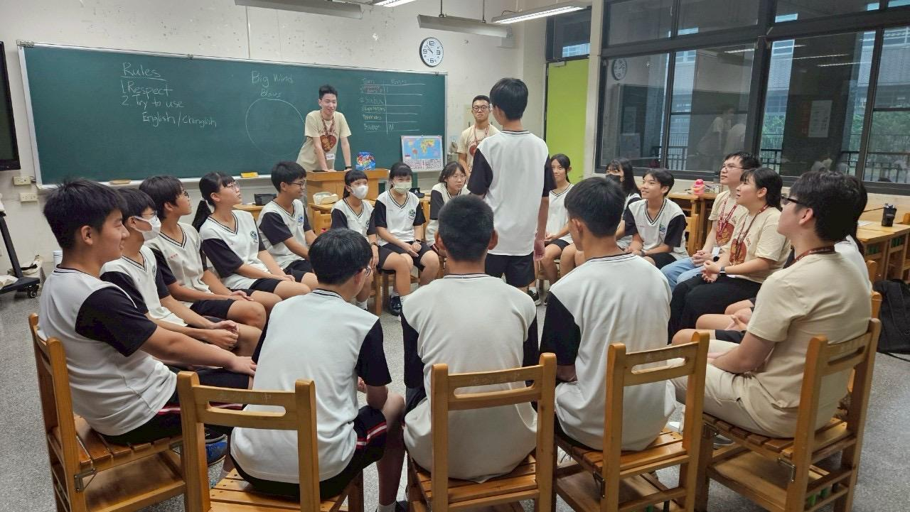

Slide 3
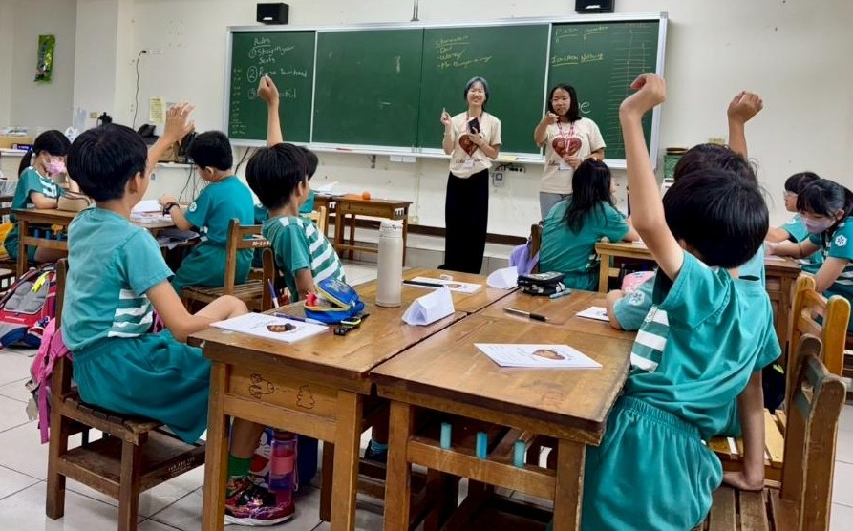

Slide 4
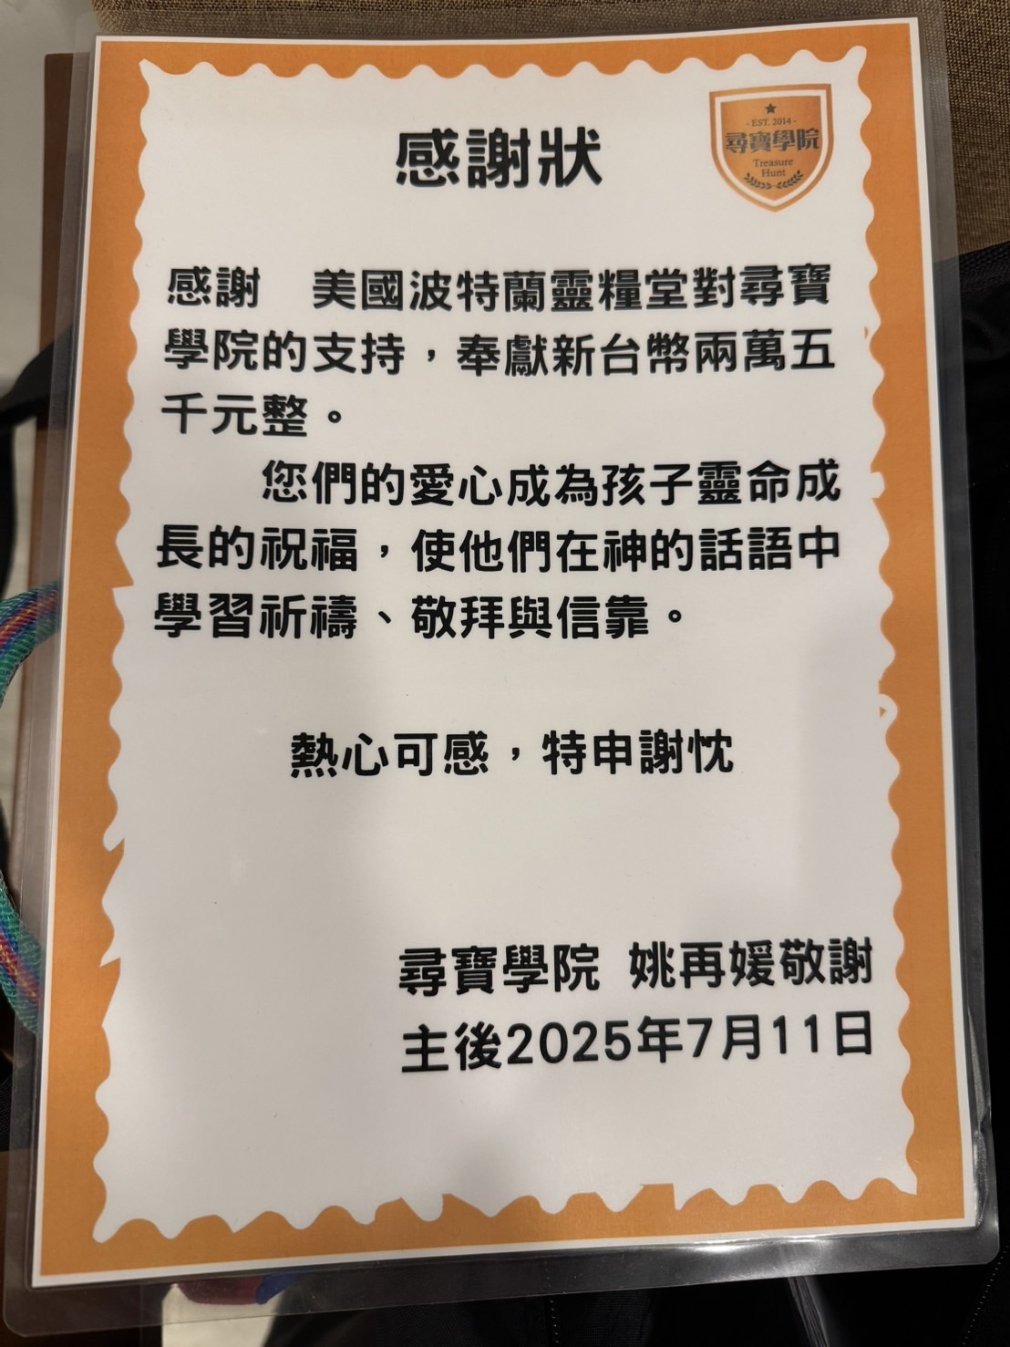


Slide 5

見證分享
夏晓东 弟兄、杨光 姐妹

Slide 6
見證分享
张振菁 姐妹

Slide 7
主日信息
Sunday Sermon

Slide 8
迎向充滿變數的旅程
Embracing a Journey Full of Uncertainties
波特蘭靈糧堂
July 13, 2025

Slide 9
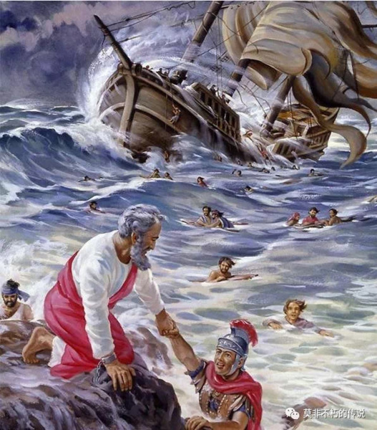

Slide 10
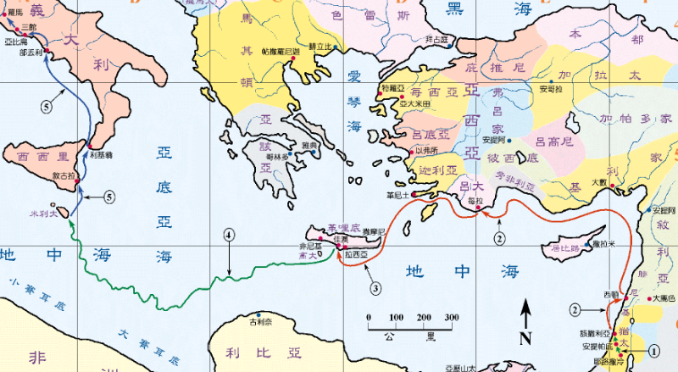

Slide 11
使徒行傳 Acts 27:21-22
眾人多日沒有吃甚麼，保羅就出來站在他們中間，說：「眾位，你們本該聽我的話，不離開克里特，免得遭這樣的傷損破壞。 現在我還勸你們放心，你們的性命一個也不失喪，惟獨失喪這船。
When they had gone a long time without food, then Paul stood up in their midst and said, “Men, you ought to have followed my advice and not to have set sail from Crete and incurred this damage and loss. Yet now I urge you to keep up your courage, for there will be no loss of life among you, but only of the ship.

Slide 12
使徒行傳 Acts 27:23-26
因我所屬所事奉的 神，他的使者昨夜站在我旁邊，說： 『保羅，不要害怕，你必定站在該撒面前，並且與你同船的人， 神都賜給你了。』 所以眾位可以放心，我信 神他怎樣對我說，事情也要怎樣成就。 只是我們必要撞在一個島上。」
For this very night an angel of the God to whom I belong and whom I serve stood before me, saying, ‘Do not be afraid, Paul; you must stand before Caesar; and behold, God has granted you all those who are sailing with you.’ Therefore, keep up your courage, men, for I believe God that it will turn out exactly as I have been told. But we must run aground on a certain island.”

Slide 13
迎向充滿變數的旅程
        堅心仰望神的寶座 ─ 神仍然坐王掌權

Slide 14
詩篇 Psalm 29:10
洪水泛濫之時，耶和華坐著為王；耶和華坐著為王，直到永遠。
The Lord sat as King at the flood;
Yes, the Lord sits as King forever.

Slide 15
迎向充滿變數的旅程
        堅心仰望神的寶座 ─ 神仍然坐王掌權
        堅心持守神的託付 ─ 對神的全然委身

Slide 16
使徒行傳 Acts 27:23
因我所屬所事奉的 神，他的使者昨夜站在我旁邊，
For this very night an angel of the God to whom I belong and whom I serve stood before me,

Slide 17
提摩太後書 2 Timothy 4:2-4
務要傳道，無論得時不得時，總要專心，並用百般的忍耐、各樣的教訓責備人，警戒人，勸勉人。 因為時候要到，人必厭煩純正的道理，耳朵發癢，就隨從自己的情慾增添好些師傅，並且掩耳不聽真道，偏向荒渺的言語。
preach the word; be ready in season and out of season; reprove, rebuke, exhort, with great patience and instruction. For the time will come when they will not endure sound doctrine; but wanting to have their ears tickled, they will accumulate for themselves teachers in accordance to their own desires, and will turn away their ears from the truth and will turn aside to myths.

Slide 18
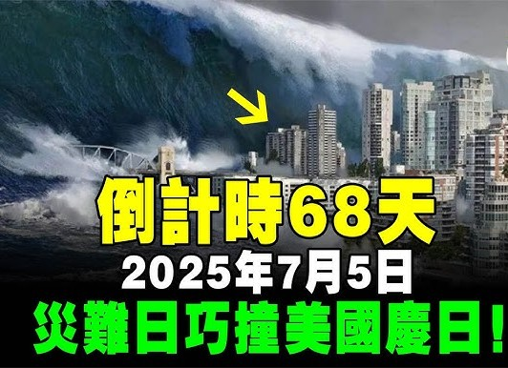

Slide 19
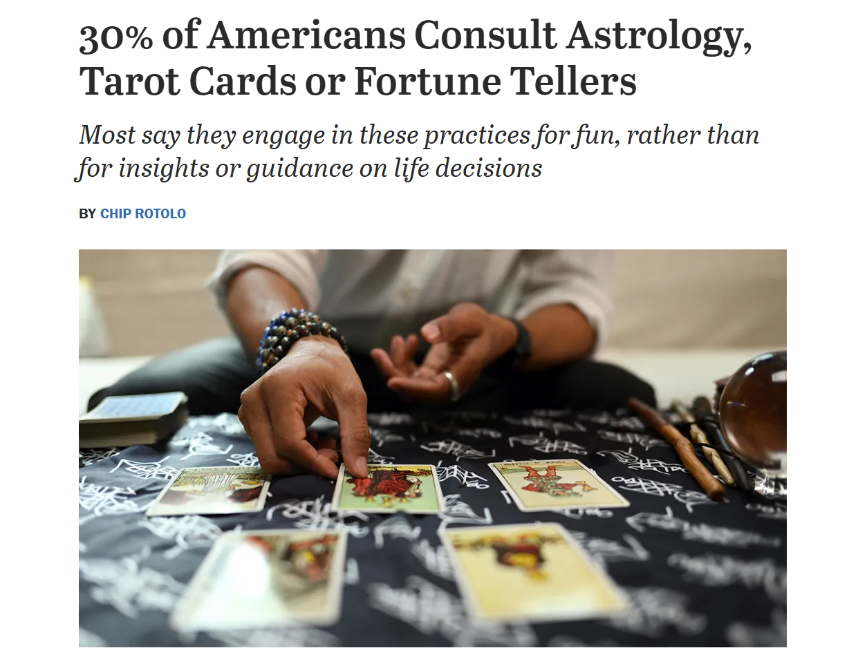

Slide 20
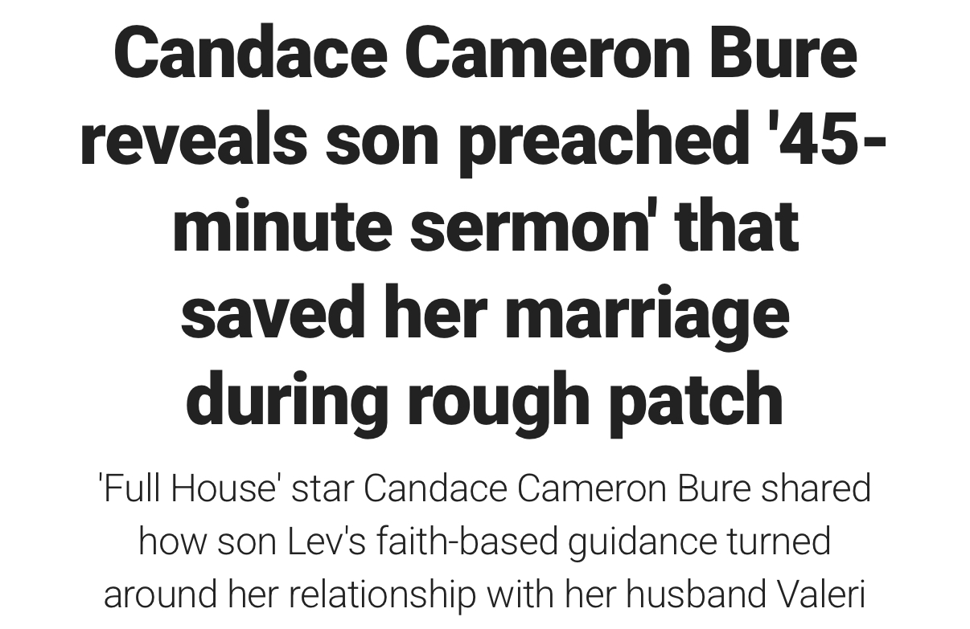


Slide 21
迎向充滿變數的旅程
        堅心仰望神的寶座 ─ 神仍然坐王掌權
        堅心持守神的託付 ─ 對神的全然委身
        堅心依靠神的話語 ─ 聖經與聆聽聖靈

Slide 22
詩篇 Psalm 119:105
你的話是我腳前的燈，是我路上的光。
Your word is a lamp to my feet
And a light to my path.

Slide 23
約翰福音 John 6:63
叫人活著的乃是靈，肉體是無益的。 我對你們所說的話就是靈，就是生命。
It is the Spirit who gives life; the flesh profits nothing; the words (ῥήματα) that I have spoken to you are spirit and are life.

Slide 24
迎向充滿變數的旅程
        堅心仰望神的寶座 ─ 神仍然坐王掌權
        堅心持守神的託付 ─ 對神的全然委身
        堅心依靠神的話語 ─ 聖經與聆聽聖靈

Slide 25
回應詩歌 Response Song
「成為神蹟的器皿」

Slide 26
小組活動花絮 Cell Group Activities

Slide 27
