Slide 1

主日信息
Sunday Sermon

Slide 2

建立「裡面的人」
Strengthening the ‘Inner Man’
波特蘭靈糧堂
July 6, 2025

Slide 3

馬可福音 Mark 3:17
還有西庇太的兒子雅各和雅各的兄弟約翰（又給這兩個人起名叫半尼其，就是雷子的意思），
and James, the son of Zebedee, and John the brother of James (to them He gave the name Boanerges, which means, “Sons of Thunder”);

Slide 4


馬可福音 Mark 3:17
還有西庇太的兒子雅各和雅各的兄弟約翰（又給這兩個人起名叫半尼其，就是雷子的意思），
and James, the son of Zebedee, and John the brother of James (to them He gave the name Boanerges, which means, “Sons of Thunder”);
雷子 ─ 暴躁如雷的人

Slide 5
羅馬書 Romans 7:21-23
我覺得有個律，就是我願意為善的時候，便有惡與我同在。 因為按著我裡面的意思（原文是人），我是喜歡 神的律；但我覺得肢體中另有個律和我心中的律交戰，把我擄去，叫我附從那肢體中犯罪的律。
I find then the principle that evil is present in me, the one who wants to do good. For I joyfully concur with the law of God in the inner man (ἄνθρωπον),

Slide 6
以弗所書 Ephesians 3:16-20
求他按著他豐盛的榮耀，藉著他的靈，叫你們心裡的力量剛強起來，使基督因你們的信，住在你們心裡，叫你們的愛心有根有基，能以和眾聖徒一同明白基督的愛是何等長闊高深，並知道這愛是過於人所能測度的，便叫 神一切所充滿的，充滿了你們。 神能照著運行在我們心裡的大力充充足足地成就一切，超過我們所求所想的。
16 that He would grant you, according to the riches of His glory, to be strengthened with power through His Spirit in the inner man,

Slide 7
以弗所書 Ephesians 3:16
求他按著他豐盛的榮耀，藉著他的靈，叫你們心裡的力量剛強起來，
that He would grant you, according to the riches of His glory, to be strengthened with power through His Spirit in the inner man (ἄνθρωπον),

Slide 8
心理學如何解釋 「Inner man 裡面的人」
Carl Rogers 人本主義心理學 Humanistic Psychology：
「真實自我（real self）」與「理想自我（ideal self）」之間的距離，如果差距過大會產生焦慮與自我否定。
「裡面的人」即是真我，一個被接納、成長、活出潛能的核心。

Slide 9
以弗所書 Ephesians 3:17-19
使基督因你們的信，住在你們心裡，叫你們的愛心有根有基，能以和眾聖徒一同明白基督的愛是何等長闊高深，並知道這愛是過於人所能測度的，便叫 神一切所充滿的，充滿了你們。
so that Christ may dwell in your hearts through faith; and that you, being rooted and grounded in love, may be able to comprehend with all the saints what is the breadth and length and height and depth, and to know the love of Christ which surpasses knowledge, that you may be filled up to all the fullness of God.

Slide 10
以弗所書 Ephesians 3:20
神能照著運行在我們心裡的大力充充足足地成就一切，超過我們所求所想的。
Now to Him who is able to do far more abundantly beyond all that we ask or think, according to the power that works within us,

Slide 11

回應詩歌 Response Song
「Power of Your Love 祢愛的大能」

Slide 12
小組活動花絮 Cell Group Activities

Slide 13
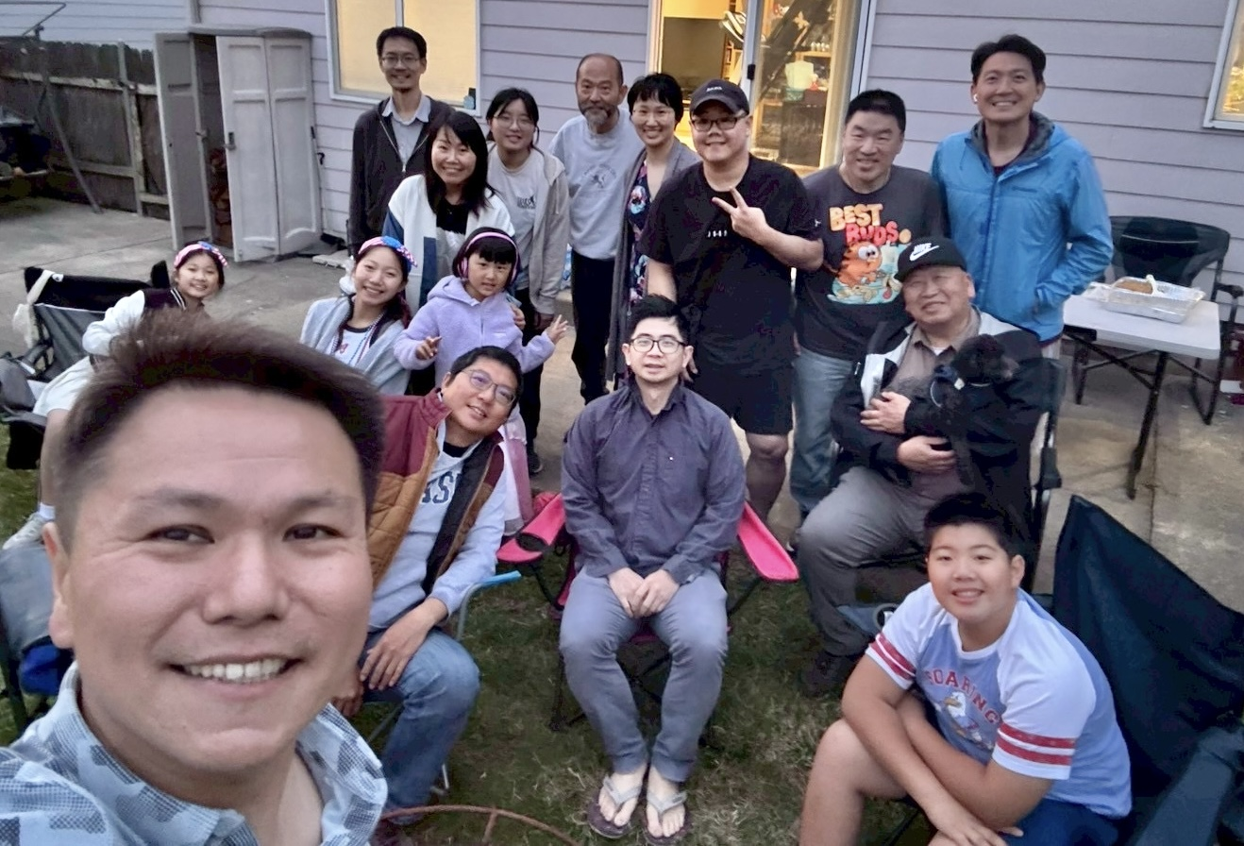

Slide 14
