Slide 1

主日信息
Sunday Sermon

Slide 2

Ignite The World Ministries
“I am the light of the world. Whoever follows me will never walk in darkness, but will have the light of life.” John 8:12

Slide 3
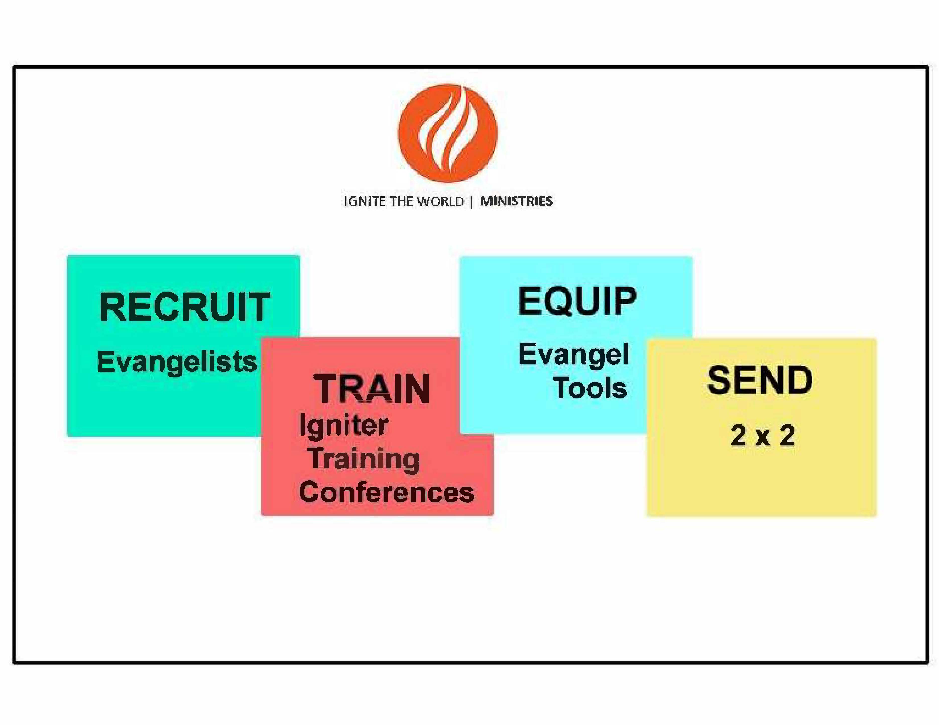
4-step evangelism strategy

Slide 4


